Slide 1
ReadingWikipedia to Answer Open-Domain Questions
Danqi Chen
Adam Fisch, Jason Weston
Antoine Bordes

Slide 2
Main Contribution
This paper proposes to tackle open-domain question answering using Wikipedia as the unique knowledge source.

Slide 3
Motivation
Many large-scale QA systems like IBM' DeepQA rely on multiple sources to answer. Namely, such systems heavily rely on information redundancy among the sources to answer correctly.
Having a single knowledge source that forces the model to be precise can evaluate the ability of a machine to read better.
Related task datasets: SQuAD, CNN/Daily Mail and CBT

Slide 4
Problem
D
A
Q
Not realistic for building an open-domain QA system!

Slide 5
Problem
Ds
A
Q

Slide 6
Challenges
1.Large-scale open-domain QA
2.Machine comprehension of text
MRS: In order to answer any question, one first retrieve the few relevant articles, and then scan them carefully to identify the answer.

Slide 7
Related Work
Microsoft's AskMSR: a search-engine based QA system that relies on data redundancy rather than sophisticated linguistic analysis.
IBM's DeepQA: a very sophisticated system that relies on both unstructured information (text documents) and structured data (KBs, databases)
YodaQA: an open source system, combining websites, information extraction, databases and Wikipedia.

Slide 8
DrQA
Two components:
(1)the Document Retriever module for finding relevant articles.
(2)a machine comprehension model, Document Reader, for extracting answers from a single document or a samll collection of documents.

Slide 9
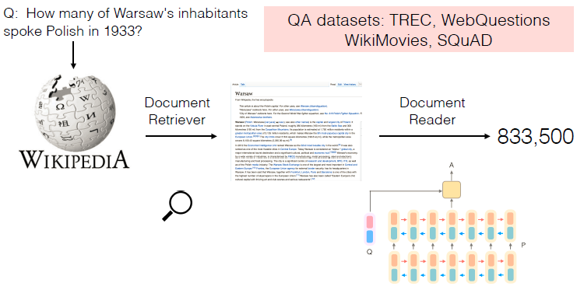
DrQA

Slide 10
Document Retriever
A simple inverted index lookup followed by term vector model scoring performs quite well.
Articiles and questions are compared as TF-IDF weighted bag-of-word vectors.(add bigram feature)
d1 BOW vector
d2 BOW vector
d3 BOW vector
...
dn BOW vector
TOP5
query BOW vector

Slide 11
Document Reader
A question q consisting of l tokens
A document or a small set of documents of n paragraphs where paragraph consists of tokens for
.

Slide 12
Document Reader
It develops an RNN model that applied to each paragraph in turn and then finally aggregate the predicted answers.

Slide 13
Paragraph Encoding
Input: ,
Output:
Here, is expected to encode useful context information around token .
RNN: three-layer bidirectional LSTM.
RNN

Slide 14
Paragraph Encoding Feature
Word embeddings: . Use the 300-dimensional Glove word embedding. and only fine-tune the 1,000 most frequent words.
Exact match: . Use three simple binary features, indicating whether pi can be exactly matched to one question word in q, either in its original, lowercased or lemma form.

Slide 15
Paragraph Encoding Feature
Token features: . Add a few manual features, which include part-of-speech(POS) and named entity recognition(NER) tags and term frequency(TF).
Aligned question embedding: .
where

Slide 16
Question Encoding
The question encoding is simpler, only apply another RNN on top of the word embedding s of qi and combine the resulting hidden units into one single vector: .
Then compute , where is a normalized weighting function which learns the importance of each question word.

Slide 17
Prediction
Train two classifiers independently for predicting the two ends of the span.
Choose the best span from token i to token i' such that
and is maximized.

Slide 18
Data
This work relies on three types of data:
(1) Wikipedia (Knowledge source)
(2) the SQuAD dataset (training Document Reader)
(3) three more QA datasets CuratedTREC, WebQuestions and WikiMovies (evaluating and testing)

Slide 19
Distantly Supervised Data
CuratedTREC, WebQuestions and WikiMovies only contain question-answer pairs, and not an associated document or paragraph as in SQuAD.
Document Retriver
Related paragraph
q from the three datasets
top5
rules filter

Slide 20
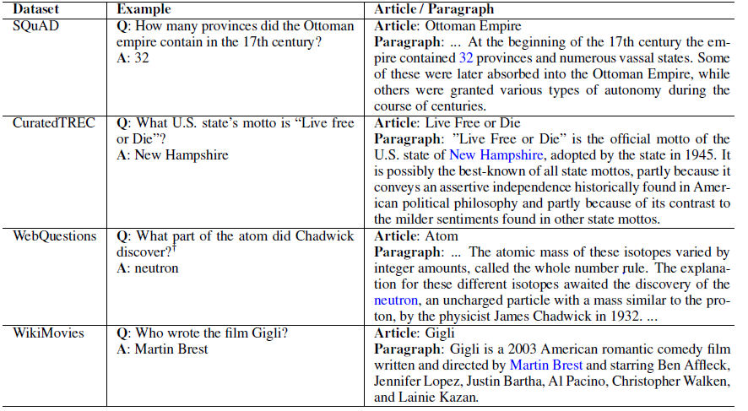
Distantly Supervised Data

Slide 21
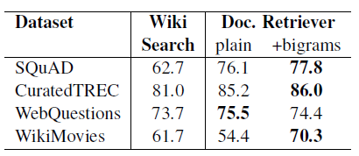
Experiments-find relevant articles

Slide 22
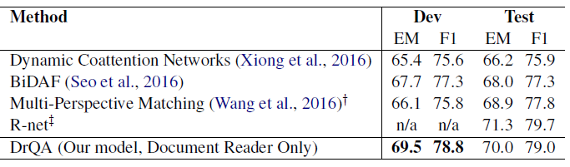
Experiments-Reader Evaluation on SQuAD

Slide 23
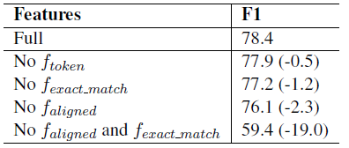
Experiments-Feature Ablation

Slide 24
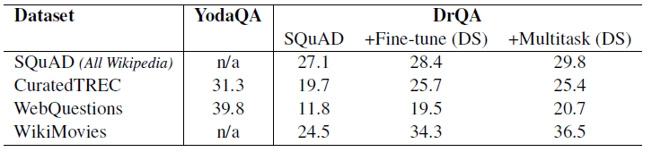
Experiments-Full Wikipedia Question Answering
SQuAD: Document Reader model is pre-trained on SQuAD training set only.
Fine-tune(DS): Document Reader model is pre-trained on SQuAD and then fine-tuned for each dataset independently.
Multitask(DS): Document Reader model is jointly trained on the SQuAD and all the DS sources.

Slide 25
Conclusion
This paper studied the task of machine reading at scale, by using Wikiperdia as the unique knowledge source for open-domain QA. And the results indicate that MRS is a key challenging task for researchers to focus on.

